Slide 1

PRESENTATION MIDTERM
RANDOM FOREST

Slide 2
NỘI DUNG BÀI THUYẾT TRÌNH
Rubic:
Bảng phân công
Thuật toán Random forest
Phân tích / tìm hiểu các vấn đề đặt ra cho Random forest?
Thu thập dữ liệu databases
Tiền xử lý dữ liệu : Data Warehouse, Data Integration (sẵn sàng training)
Phân tích/ đánh giá kết quả
Sử dụng tri thức: Ứng dụng thực tế

Slide 3
BẢNG PHÂN CÔNG CÔNG VIỆC
MSSV | Họ và tên | Công việc, nhiệm vụ | Mức độ hoàn thành
 |  | Slide 1-22
 |  | 23-25
 |  | 26-35
 |  | 36-44
 |  | Phân tích số liệu
 |  | Code thuyết trình

Slide 4
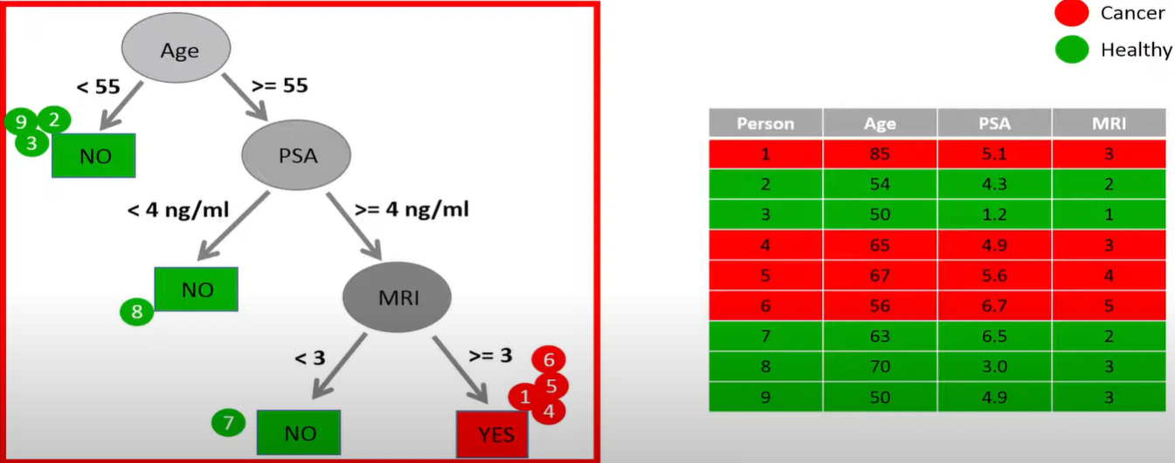
Decision tree

Slide 5
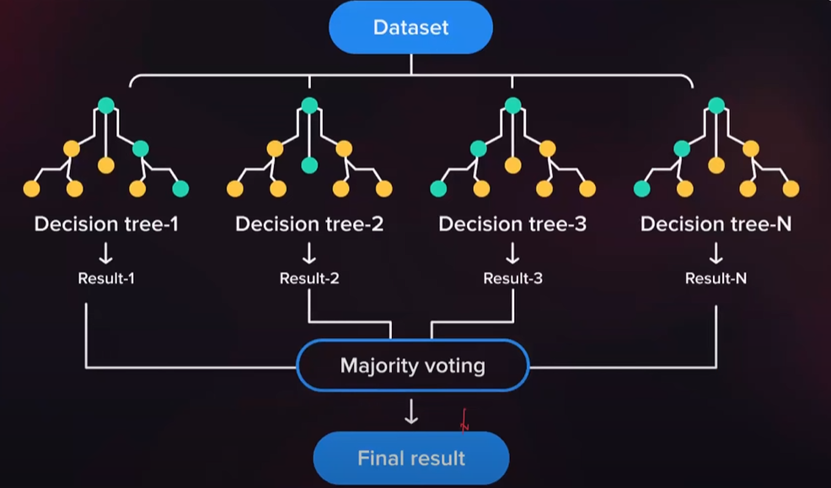
What is a random forest?
A random forest is a supervised machine learning technique that’s used to solve regression and classification problems.
Instead of building a single decision tree and use it to make predictions, build many slightly different trees and combine their predictions
It predicts by taking the average or mean of the output from various trees. Increasing the number of trees increases the precision of the outcome.

Slide 6
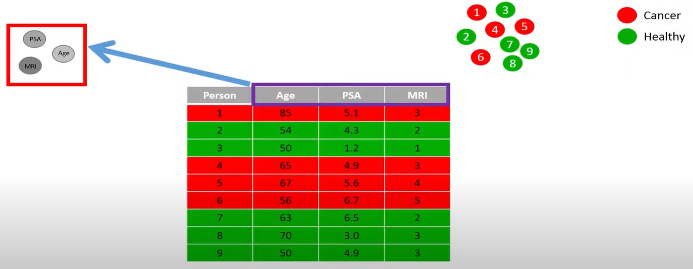
Random forest classification

Slide 7
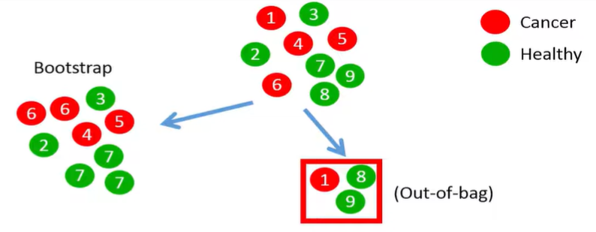
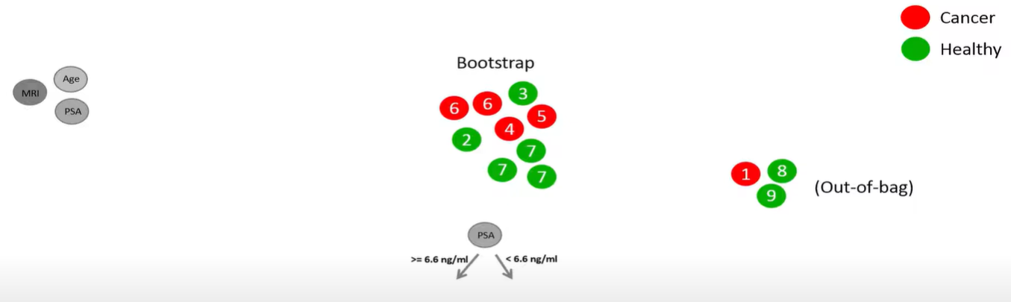
Random forest classification

Slide 8
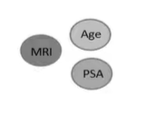
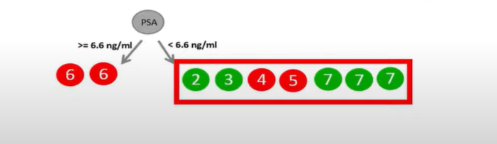
Random forest classification

Slide 9
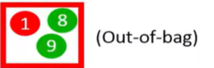
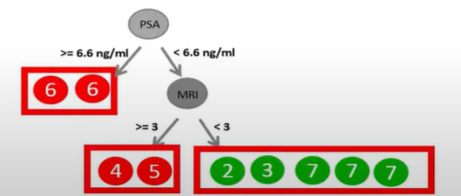
Random forest classification

Slide 10
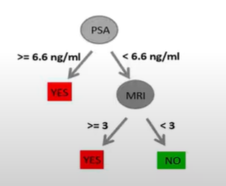
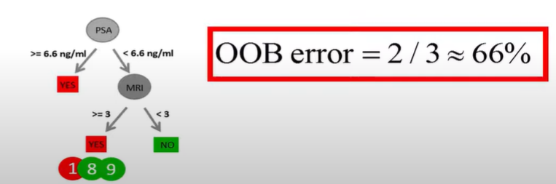
Random forest classification

Slide 11
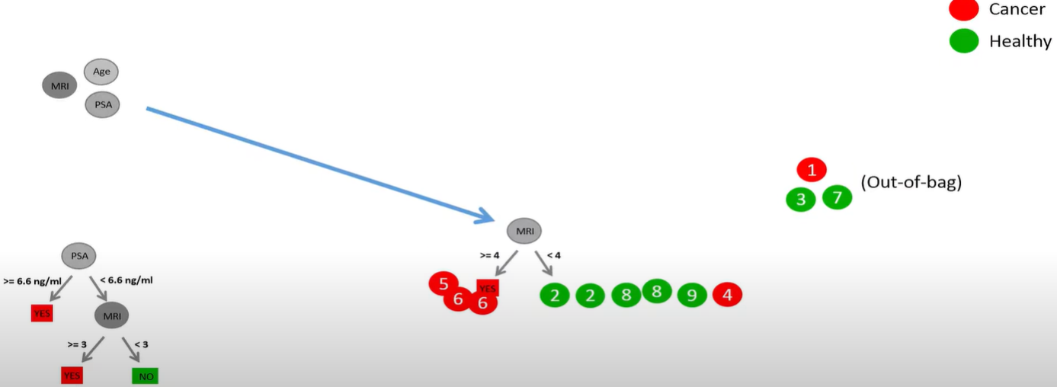
Random forest classification

Slide 12
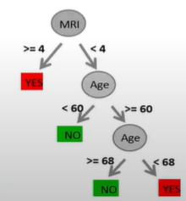
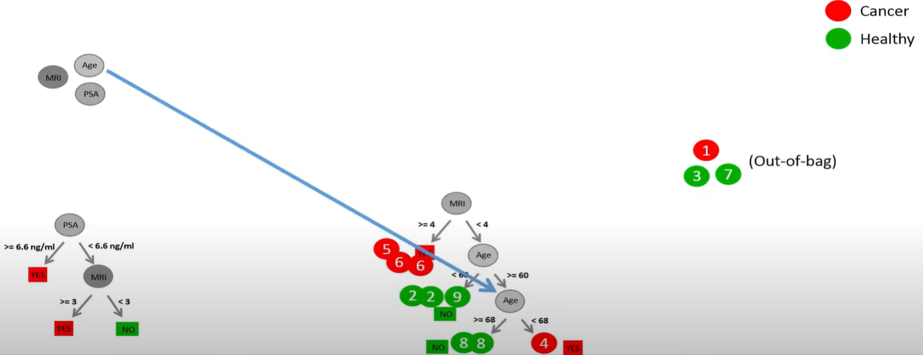
Random forest classification

Slide 13
Random forest classification

Slide 14
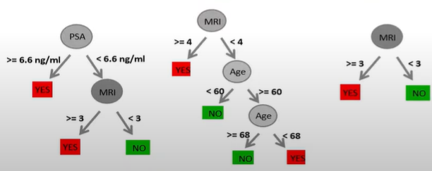
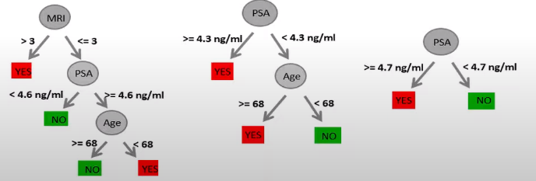
Random forest classification

Slide 15
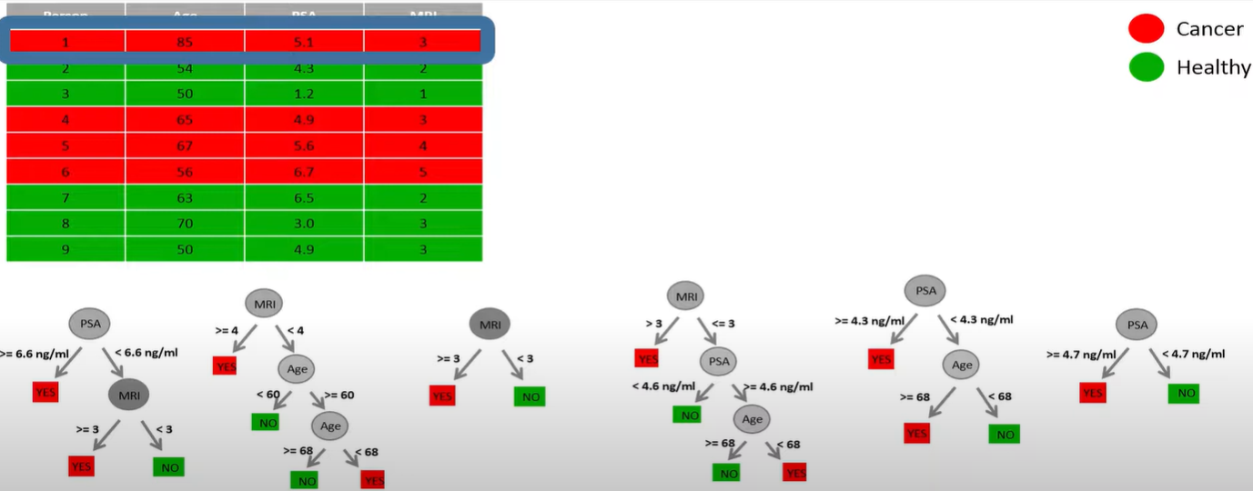
Random forest classification

Slide 16
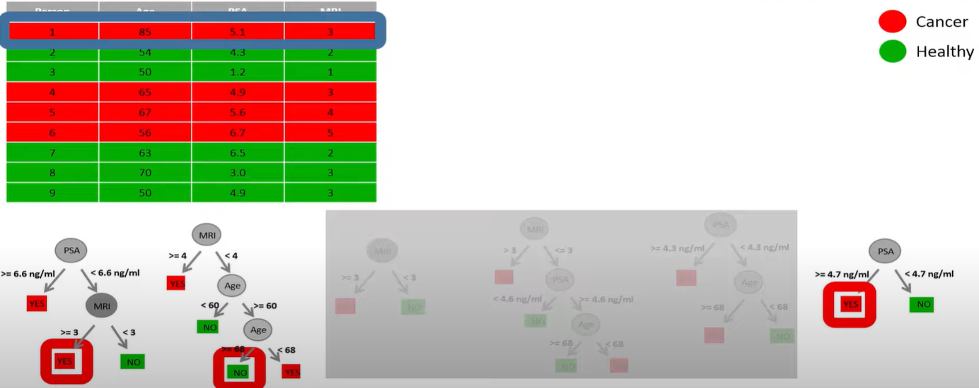
Random forest classification

Slide 17
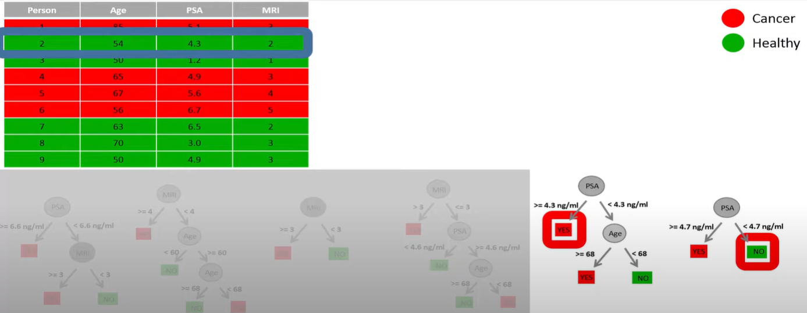
Random forest classification

Slide 18
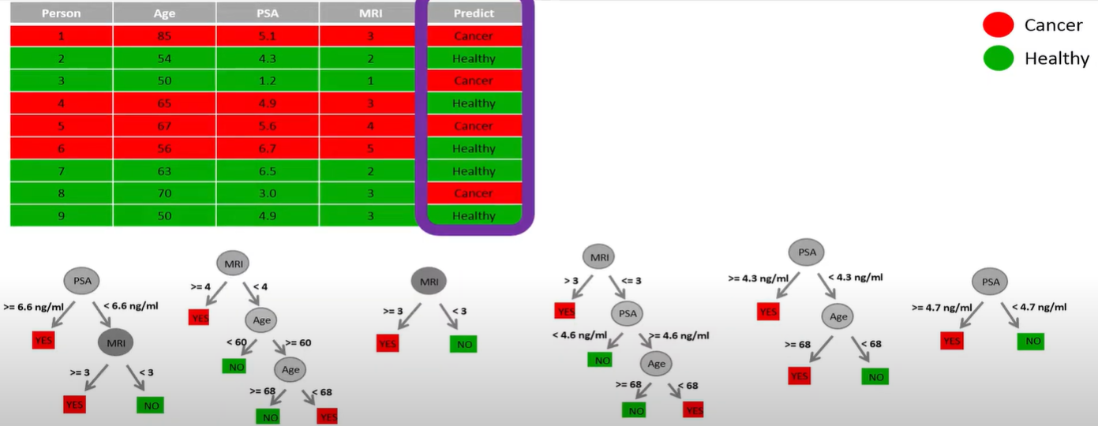
Random forest classification

Slide 19
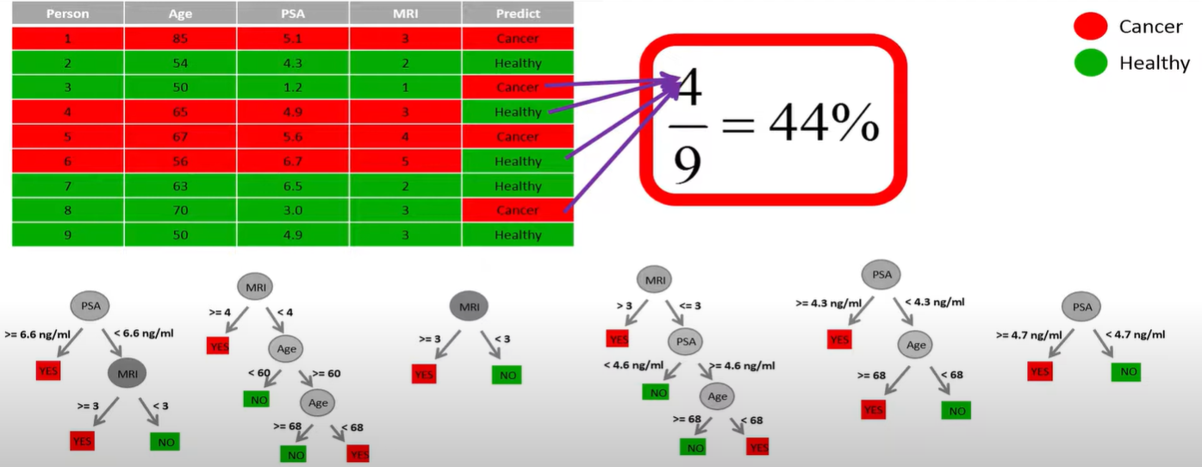
Random forest classification

Slide 20
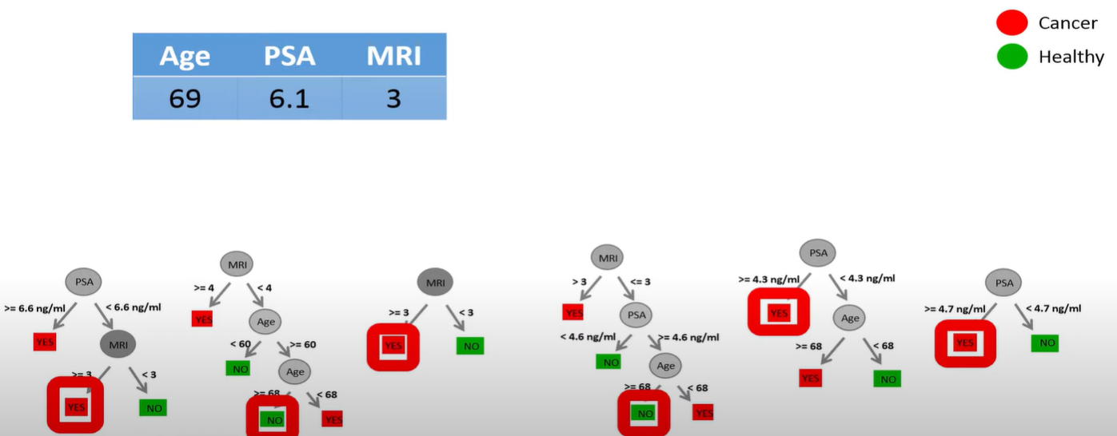
Random forest classification

Slide 21

How random forest algorithm works
In the first stage, randomly select “k” features out of total m features and build the random forest:
Randomly select k features from a total of m features where k < m.
Among the k features, calculate the node d using the best split point.
Split the node into daughter nodes using the best split.
Repeat 1 to 3 steps until l number of nodes has been reached.
Build forest by repeating steps 1 to 4 for n number of times to create n number of trees.
In the second stage, make predictions using the trained random forest algorithm:
We take the test features and use the rules of each randomly created decision tree to predict the outcome and stores the predicted outcome.
Then, we calculate the votes for each predicted target.
Finally, we consider the high voted predicted target as the final prediction from the random forest algorithm.

Slide 22
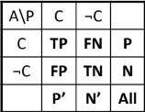
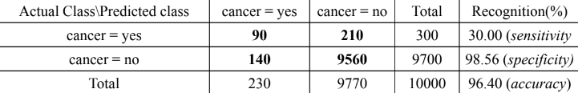
Classifier Evaluation Metrics: Accuracy,
Error Rate, Sensitivity and Specificity
Accuracy = (TP + TN)/All
Error rate = 1 - Accuracy = (FP + FN)/All
True Positive recognition rate = Sensitivity = TP/P
True Negative recognition rate = Specificity = TN/N
Accuracy = (90 + 9560)/1000
Error rate = 1 - Accuracy = 1 - ((90 + 9560)/1000)
True Positive recognition rate = Sensitivity = 90/300
True Negative recognition rate = Specificity = 9560/9700

Slide 23
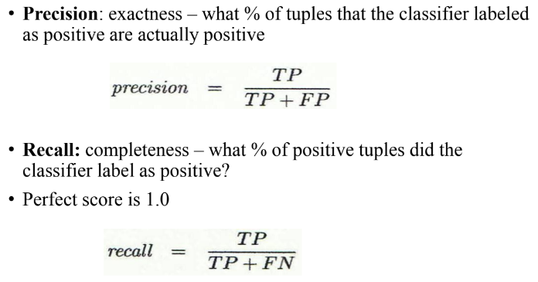
Classifier Evaluation Metrics:
Precision and Recall, and F-measures
Precision: 90/230
Recall: 90/300

Slide 24
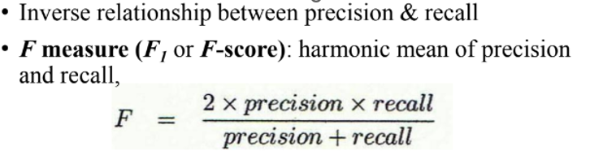
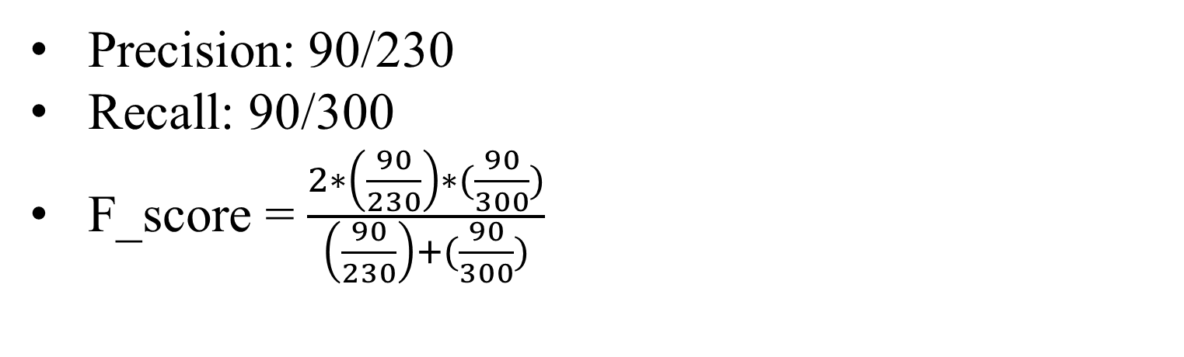
Classifier Evaluation Metrics:
Precision and Recall, and F-measures
Precision: 90/230
Recall: 90/300
F_score = $\frac{2∗\left(\frac{90}{230}\right)∗(\frac{90}{300})}{\left(\frac{90}{230}\right)+(\frac{90}{300})}$

Slide 25
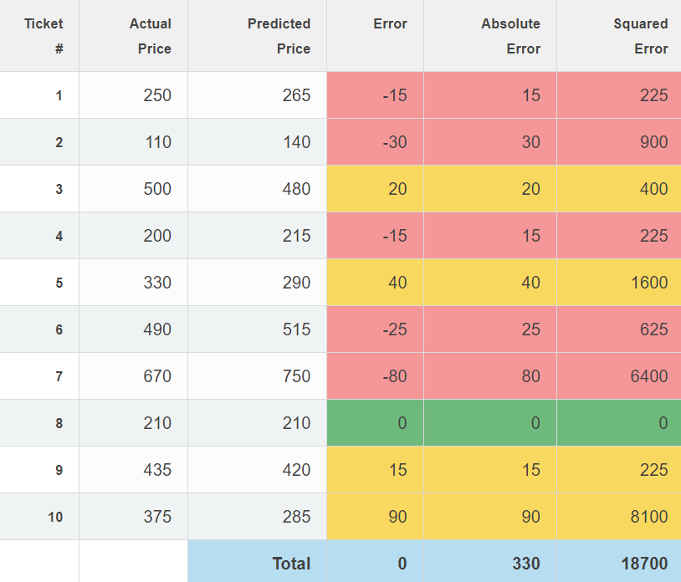
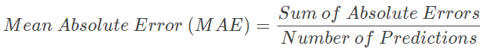
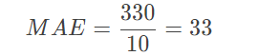
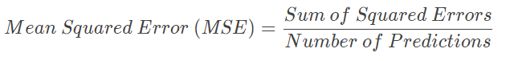
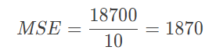
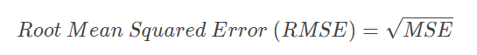
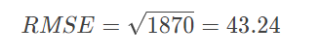
Evaluation for regression

Slide 26
Advantages and Disadvantages
Advantages | Disadvantages
Can perform both regression and classification tasks. | While using a Random Forest Algorithm, more resources are required for computation.
Produces good predictions that can be understood easily. | It consumes more time compared to the decision tree algorithm.
Can handle large data sets efficiently. It enhances the accuracy of the model and prevents the overfitting issue. | Less intuitive when we have an extensive collection of decision trees.
Random Forest works well with both categorical and continuous variables. | Extremely complex and requires more computational resources.

Slide 27
Decision Trees vs. Random Forests Which One Is Better and Why?
Random forests typically perform better than decision trees due to the following reasons:
Random forests solve the problem of overfitting because they combine the output of multiple decision trees to come up with a final prediction.
When you build a decision tree, a small change in data leads to a huge difference in the model’s prediction. With a random forest, this problem does not arise since the data is sampled many times before generating a prediction.

Slide 28
Decision Tree and Random Forest
Decision Trees | Random Forest
They usually suffer from the problem of overfitting if it’s allowed to grow without any control. | Since they are created from subsets of data and the final output is based on average or majority ranking, the problem of overfitting doesn’t happen here.
A single decision tree is comparatively faster in computation. | It is slower.
They use a particular set of rules when a data set with features are taken as input. | Random Forest randomly selects observations, builds a decision tree and then the result is obtained based on majority voting. No formulas are required here.

Slide 29
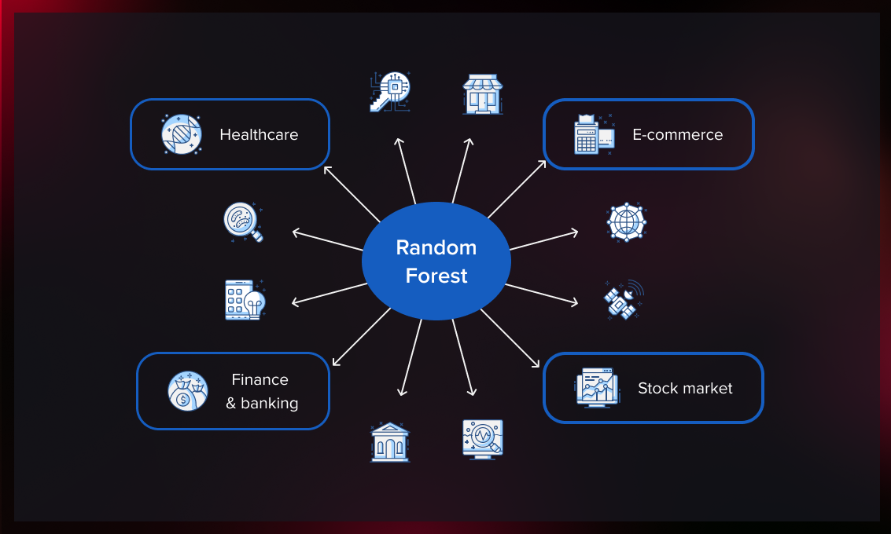
Applications of Random Forest Algorithm
Health Care: Patients are diagnosed by assessing their previous medical history. Past medical records are reviewed to establish the proper dosage for the patients.
Banking: It predicts a loan applicant’s solvency. This helps lending institutions make a good decision on whether to give the customer loan or not.
Stock Market: Financial analysts use it to identify potential markets for stocks.
E-Commerce: Through this system, e-commerce vendors can predict the preference of customers based on past consumption behaviour.

Slide 30
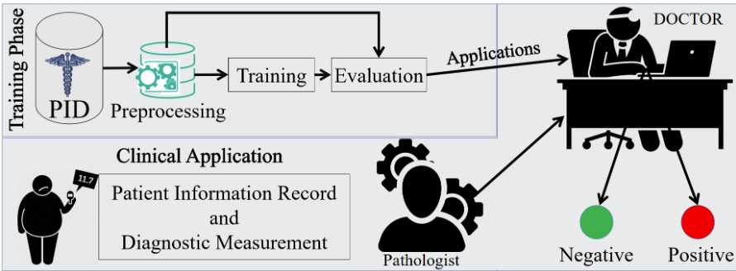
Diabetes Prediction

Slide 31
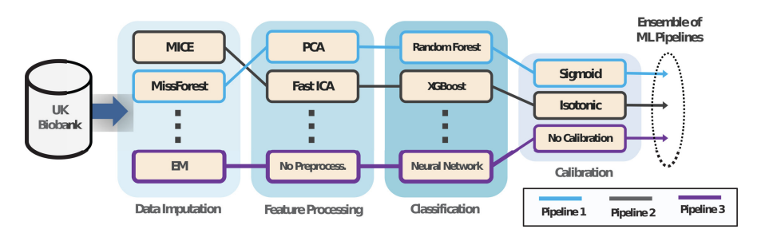
Cardiovascular Disease Prediction

Slide 32
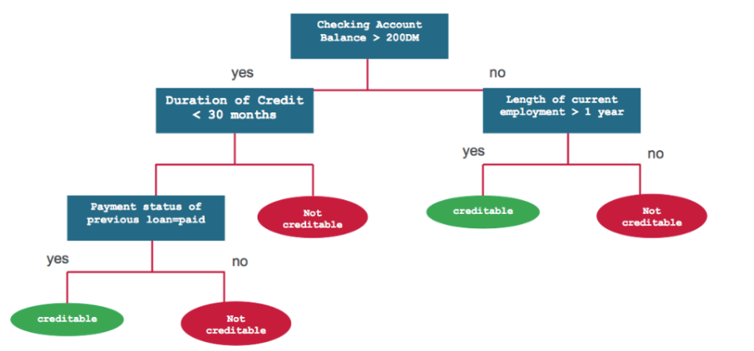
Banking Industry

Slide 33
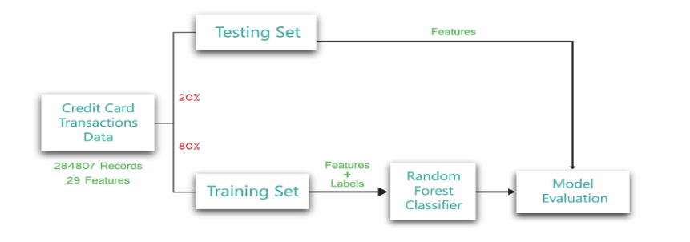
Credit Card Fraud Detection

Slide 34
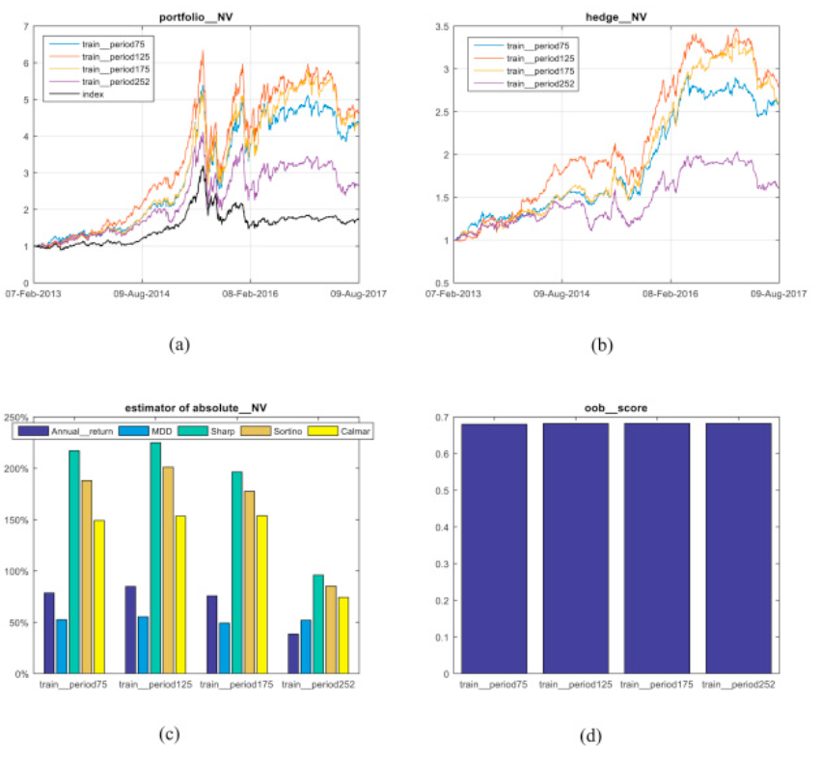
Stock Market Prediction

Slide 35
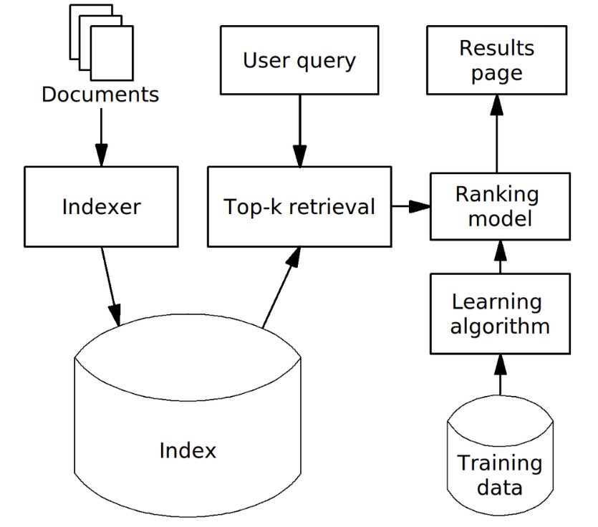
Search Ranking

Slide 36
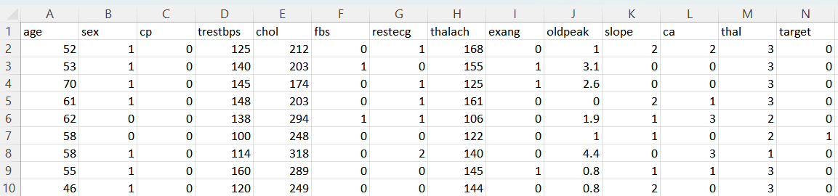
Heart Disease Dataset (Kaggle)

Slide 37
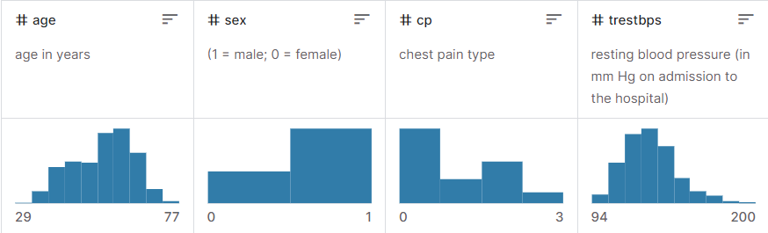
Heart Disease Dataset

Slide 38
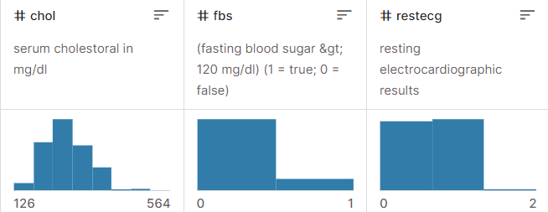
Heart Disease Dataset

Slide 39
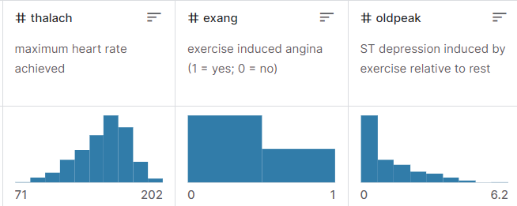
Heart Disease Dataset

Slide 40
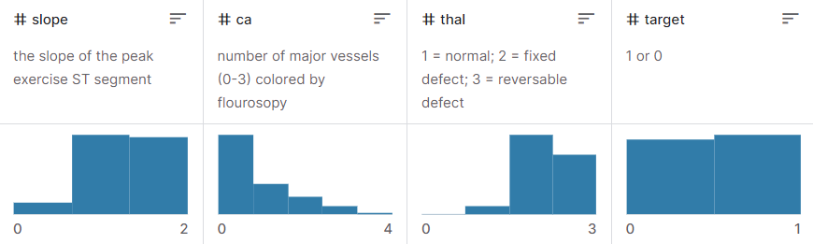
Heart Disease Dataset

Slide 41
Heart Disease Dataset

Slide 42
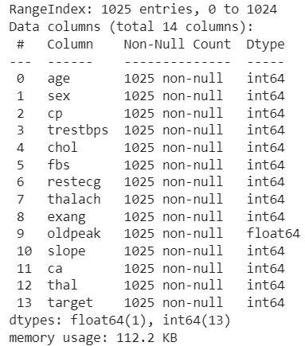
Information of heart data

Slide 43
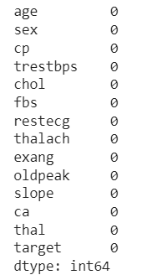
How to Handle Missing Data?
Deleting the column, row with missing data
Filling the Missing Values – Imputation
Filling the missing data with the mean or median value if it’s a numerical variable.
Filling the missing data with mode if it’s a categorical value.
Filling the numerical value with 0 or -999, or some other number that will not occur in the data. This can be done so that the machine can recognize that the data is not real or is different.
Filling the categorical value with a new type for the missing values.
3. Random Sample Imputation
4. Imputation with a model

Slide 44
Random Forest Hyperparameters
1. INCREASING THE PREDICTIVE POWER
2. INCREASING MODEL’S SPEED
n_estimators: just the number of trees the algorithm builds before taking the maximum voting or taking the averages of predictions. In general, a higher number of trees increases the performance and makes the predictions more stable, but it also slows down the computation.
max_features, which is the maximum number of features random forest considers to split a node.
min_sample_leaf. This determines the minimum number of leafs required to split an internal node.
n_jobs: how many processors it is allowed to use. If it has a value 1, it can only use one processor. “-1” means that there is no limit.
random_state: makes the model’s output replicable. The model will always produce the same results when it has a definite value of random_state and if it has been given the same hyperparameters and the same training data.
oob_score (also called oob sampling: a random forest cross-validation method. In this sampling, about one-third of the data is not used to train the model and can be used to evaluate its performance. These samples are called the out-of-bag samples.

Slide 45
CẢM ƠN THẦY VÀ CÁC BẠN ĐÃ LẮNG NGHE

